Slide 1
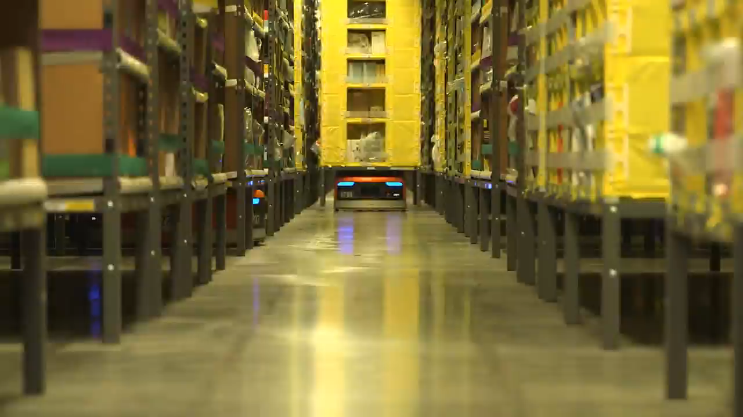

Slide 2
Will artificial intelligence make
human unemployed?
Chenman Song 宋沉蔓 2016216105
Ruize Han 韩瑞泽 2016216085
Dongxu Miao 缪东旭 2016218041
Chen Cui 崔晨 2016216078

Slide 3
Chen Cui

Slide 4
Will we lose our job?
Will artificial intelligence make human unemployed?

Slide 5
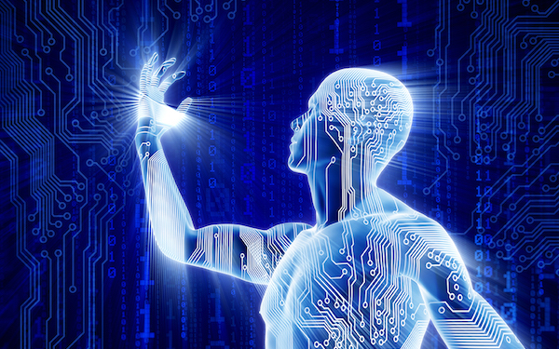
Artificial Intelligence
The answer is yes.

Slide 6
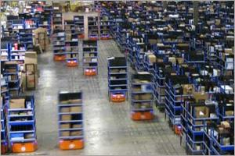
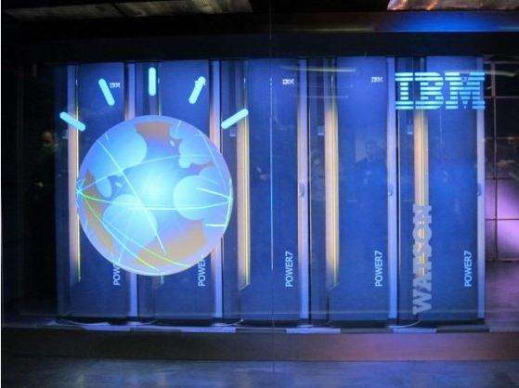
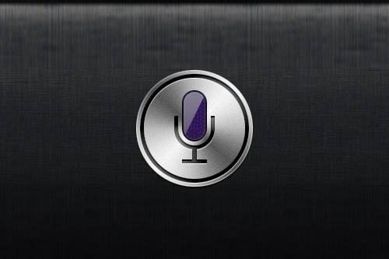
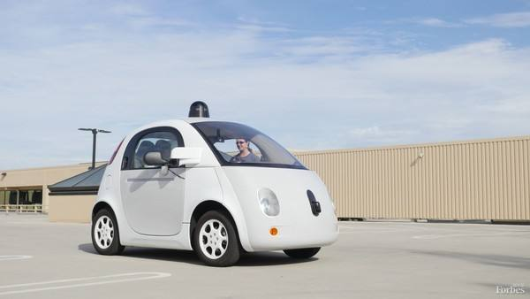
The developments of artificial intelligence
Kiva intelligent warehousing system
Watson Supercomputer
Siri voice assistant
self-driving Google car

Slide 7
Are you afraid of it?

Slide 8
Chenman Song

Slide 9
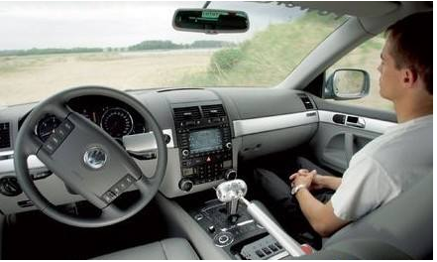
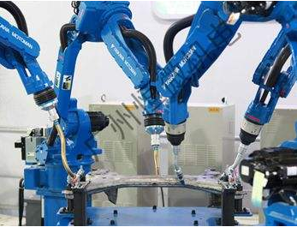
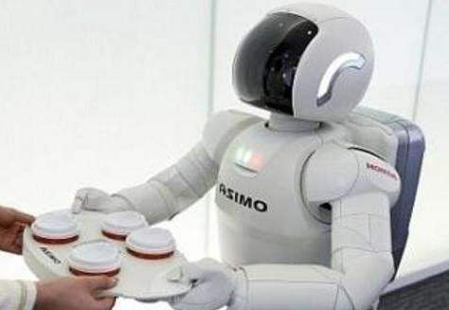
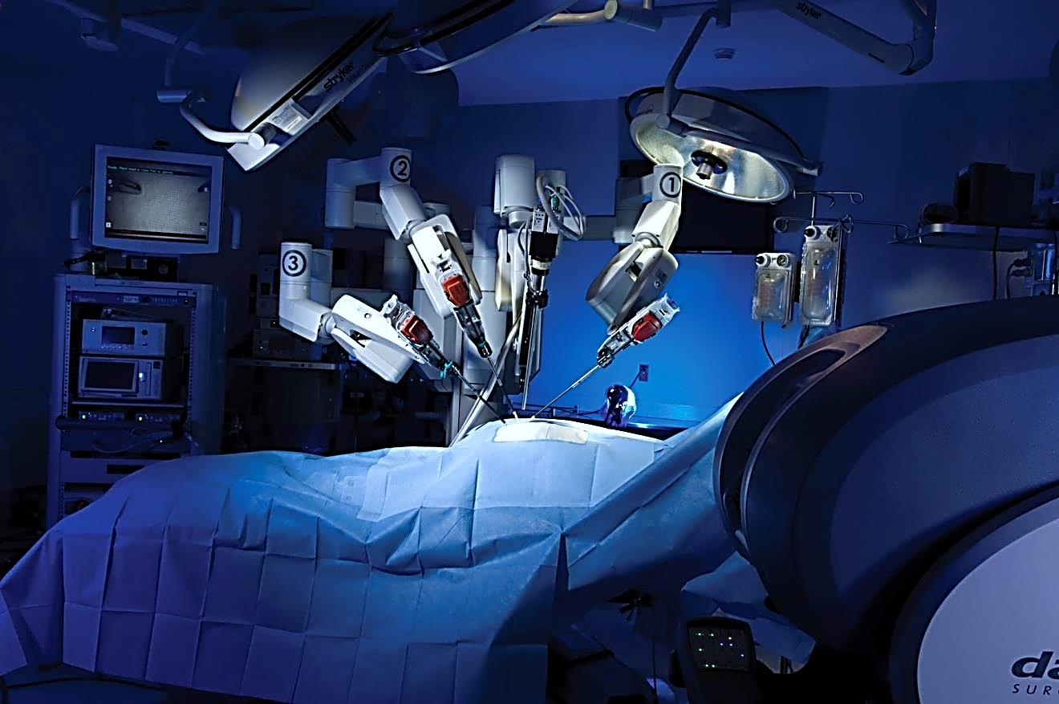
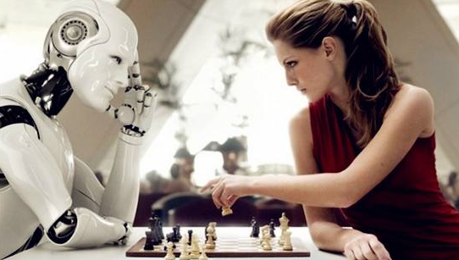
AI

Slide 10
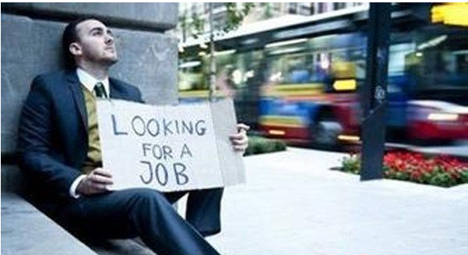
Will that be true?

Slide 11

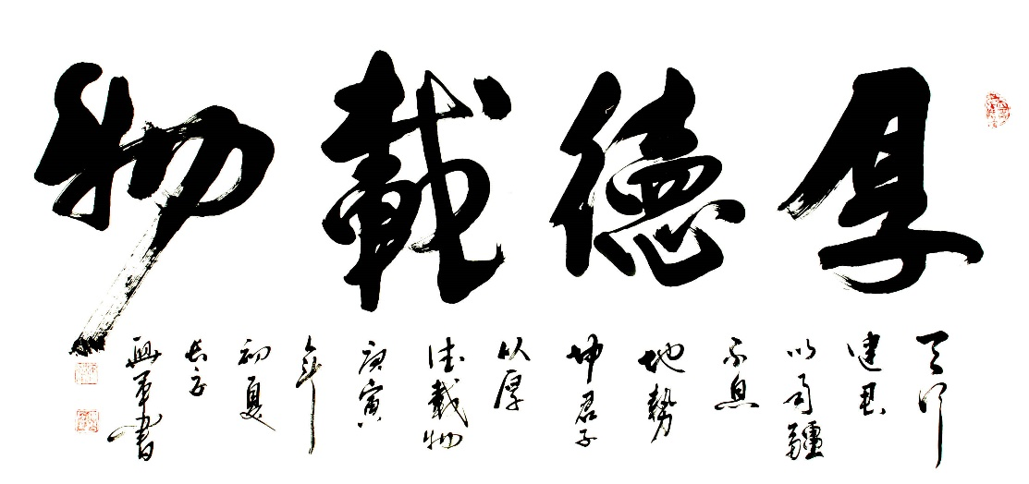
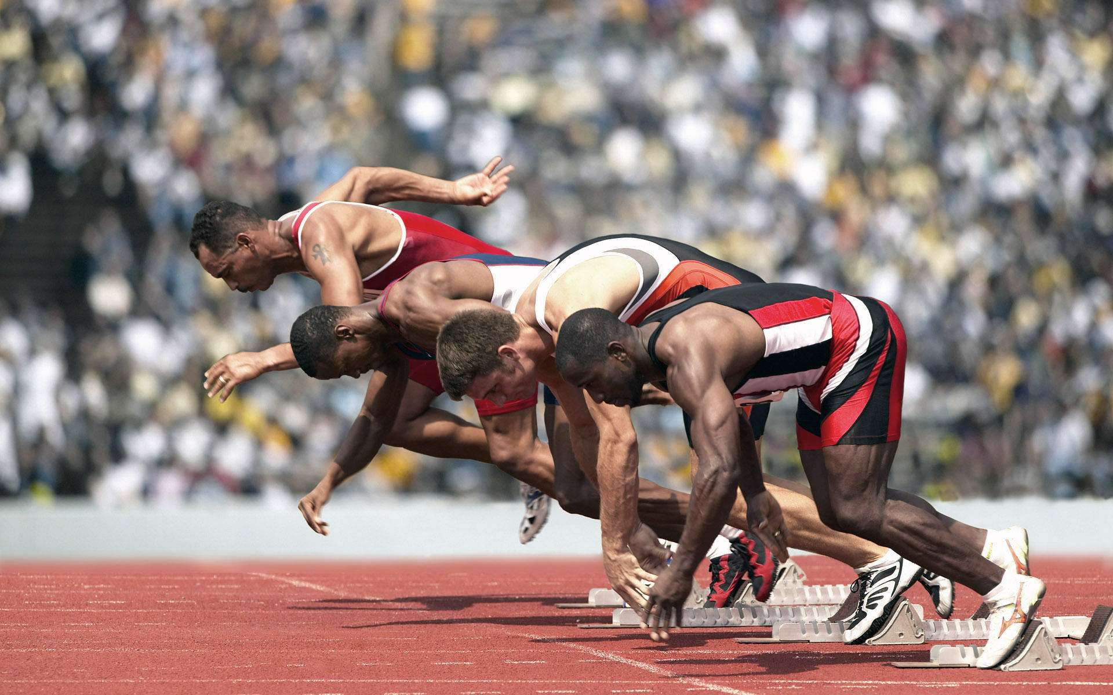


Slide 12
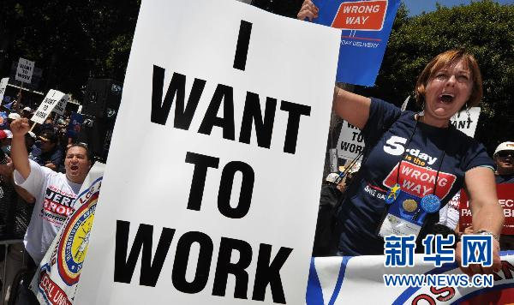
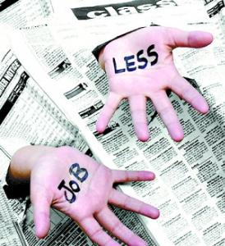
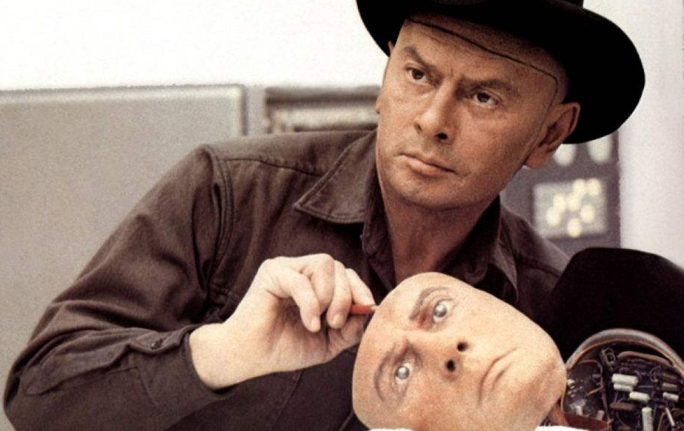
Human and Intelligent Robots

Slide 13
Ruize Han

Slide 14
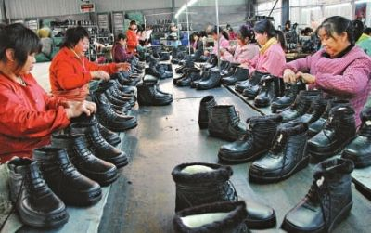
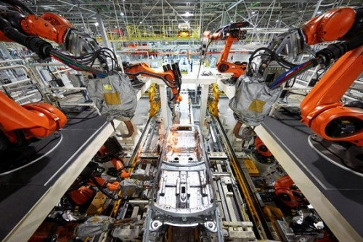
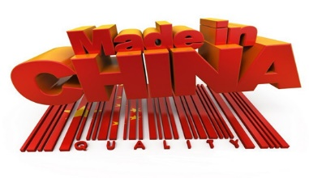
In the past
Today

Slide 15

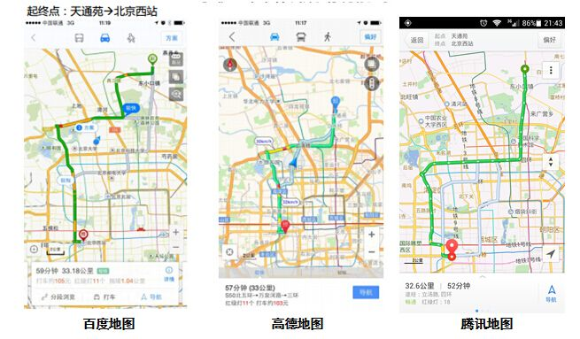


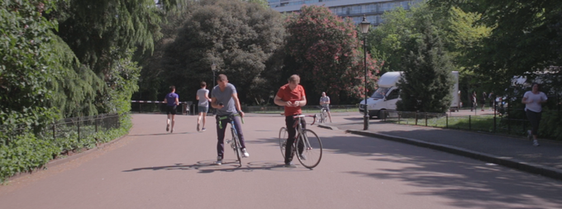
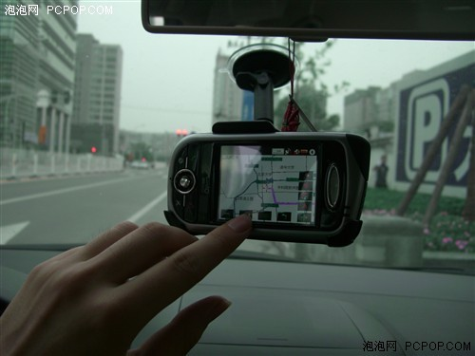
In the past
Today

Slide 16
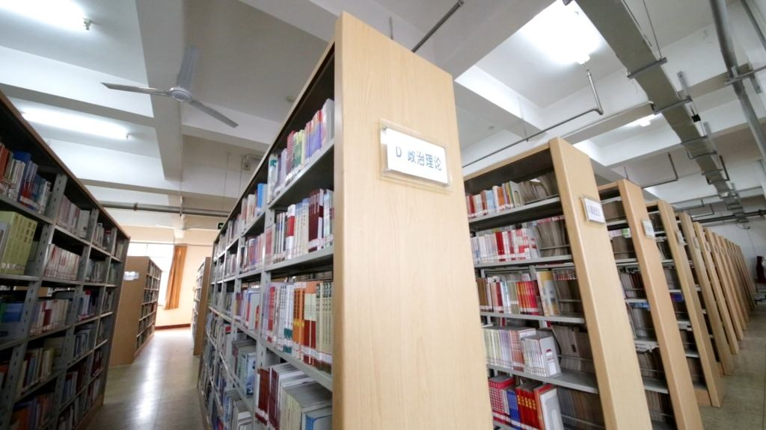
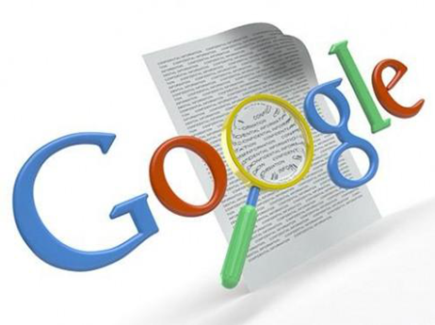
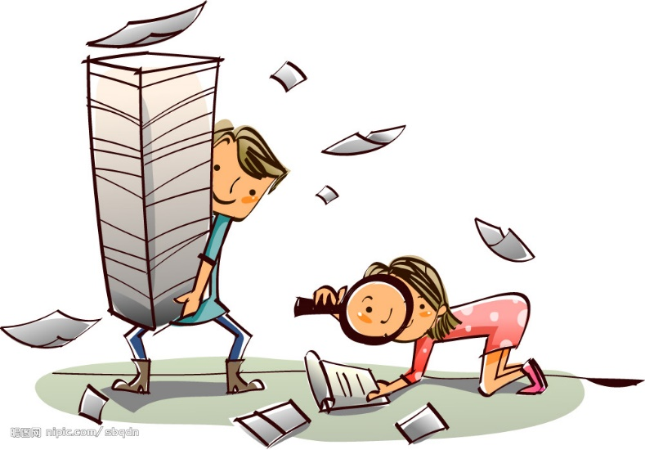

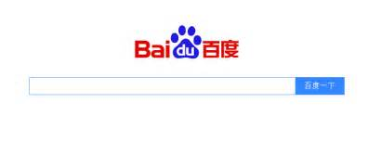
In the past
Today

Slide 17
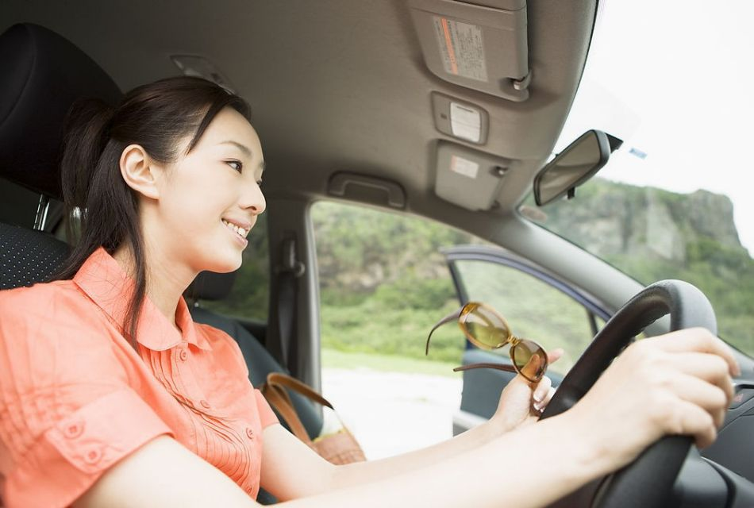
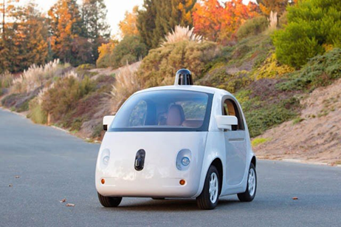
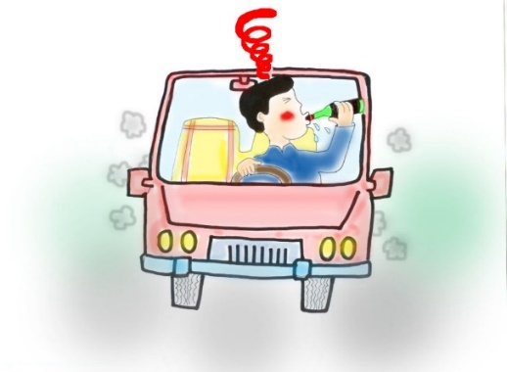
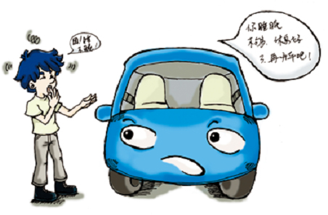
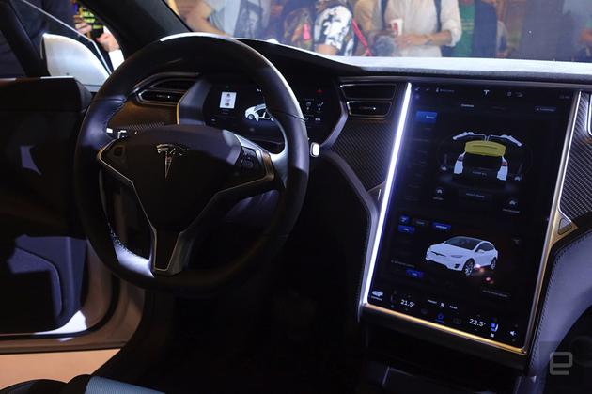
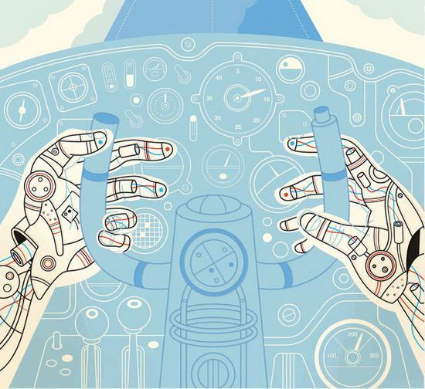
Today
In the future

Slide 18
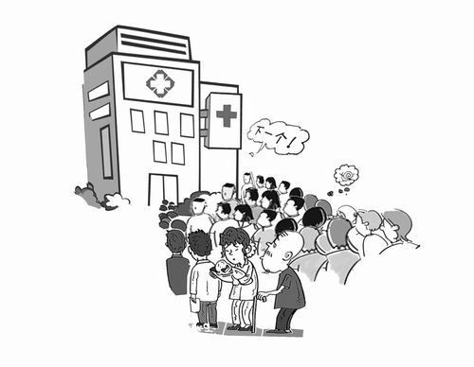
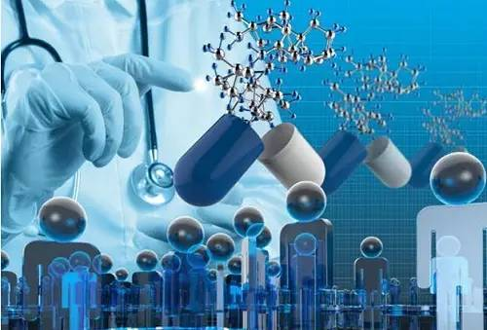
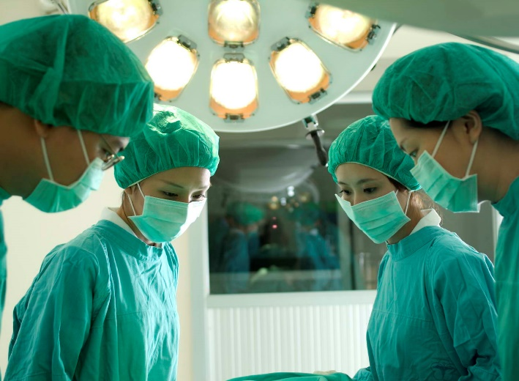
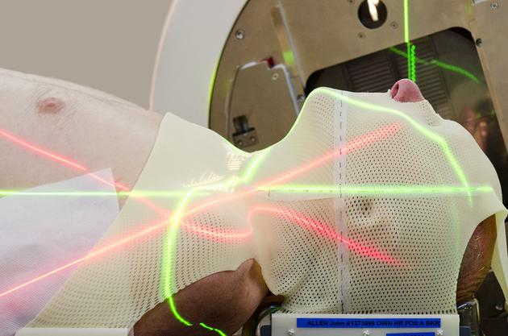
Today
In the future

Slide 19

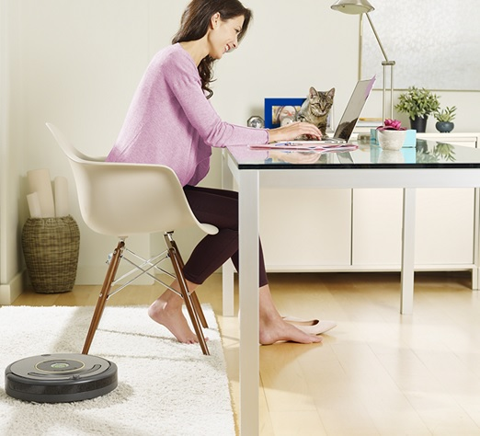

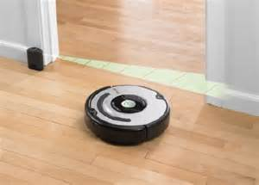

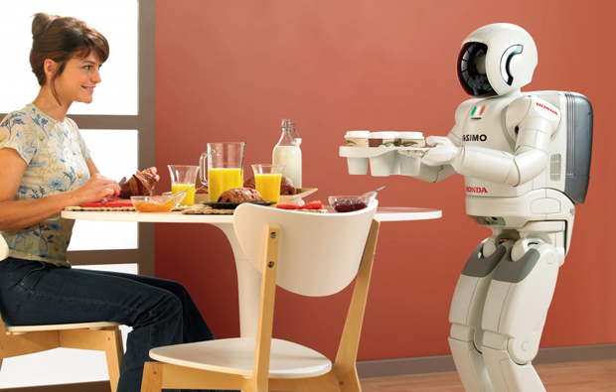
Today
In the future

Slide 20
Dongxu Miao

Slide 21
Every technological revolution take over someing, but bring more.

Slide 22
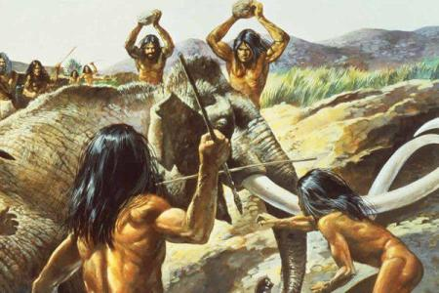
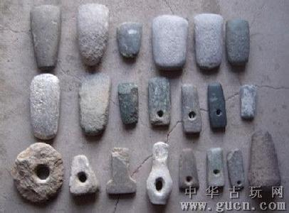
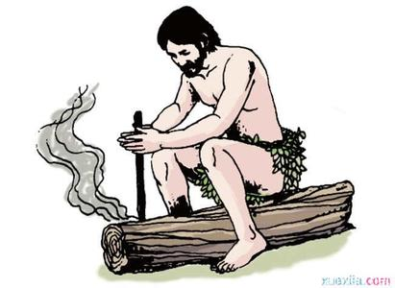
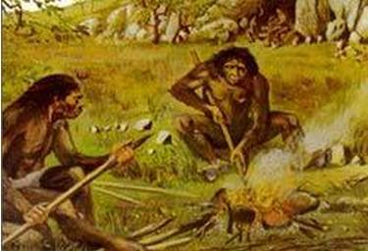
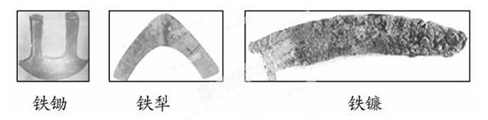
Technological revolution -- fire

Slide 23
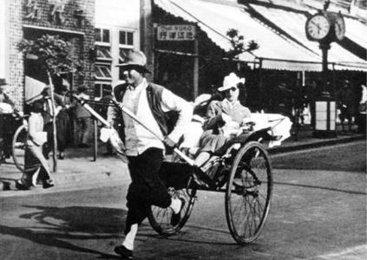
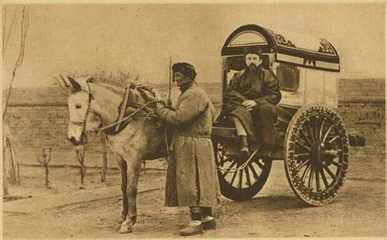
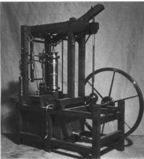
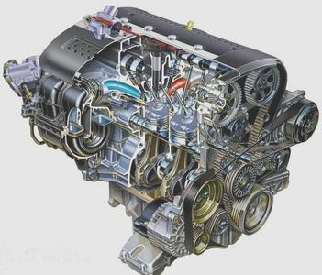

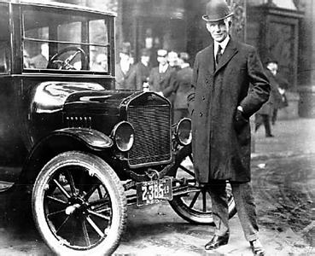

Technological revolution -- steam engine & combustion engine

Slide 24






Technological revolution -- electric power

Slide 25





Technological revolution -- AI

Slide 26
Free Debate

Slide 27







Slide 28









Slide 29
Conclusion

Slide 30
Will AI make human unemployed?
Yes
No
The technology of AI will be more and more mature and applied to more fields.
For many jobs, AI will do equal to or better than human.
With lots of work completed by AI, human will have more time to do something interesting and enjoy the life.
The technology of AI is not always correct，how to solve the problem caused by AI is controversial.
In some emotional and creative works, AI cannot replace human.
The technology of AI will create lots of new jobs when it actually replace some one.

Slide 31




THANKS
Chenman Song 宋沉蔓 2016216105
Ruize Han 韩瑞泽 2016216085
Dongxu Miao 缪东旭 2016218041
Chen Cui 崔晨 2016216078

